Slide 1

DDOS ATTACK DETECTION AND MITIGATION IN SDN: ML ASSISTED APPROACH
Course Instructor: Dr. Sudipta Saha

Slide 2
Contents:
What is sdn?
Ddos attacks and its types
Simulating a network using mininet and RYU controller
Simulating ddos attack
Proposed detection algorithm
Detection Procedure
Mitigation algorithm
Dataset features
RESULTS
REferences

Slide 3
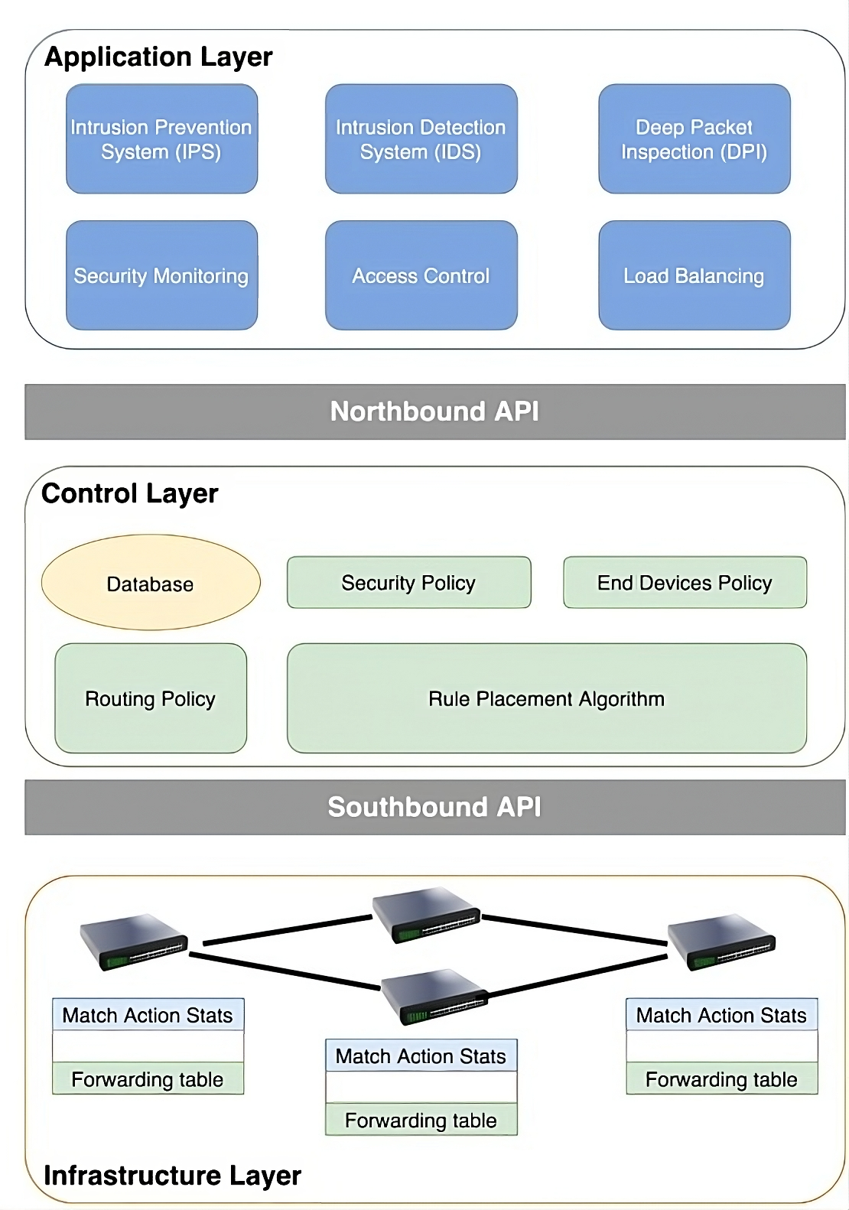
What is sdn?
Centralized Control: Decouples control from hardware for programmable networks.
Streamlined Management: Simplifies network configuration and oversight.
Open Protocols: Promotes compatibility and vendor independence.
Network Agility: Facilitates dynamic resource allocation.
Security: Improves network monitoring and policy enforcement.

Slide 4
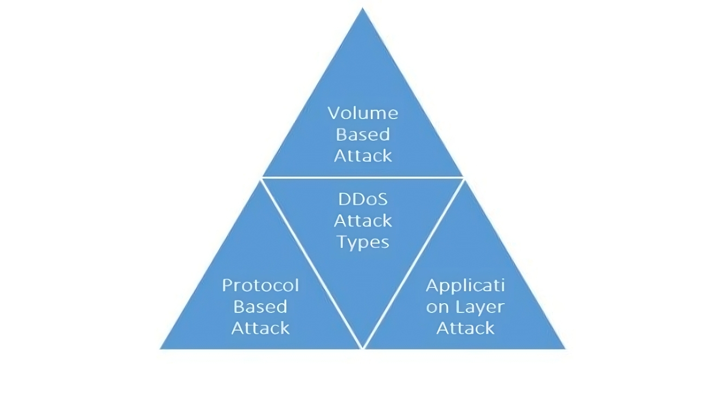
Ddos attacks and its types:
A Distributed Denial-of-Service (DDoS) attack is a cybercrime in which the attacker floods a server with internet traffic to prevent users from accessing connected online services and sites. Here are the types of DDoS attacks:
Volumetric: Floods with traffic to saturate bandwidth.
Protocol: Targets infrastructure to drain system resources.
Application Layer: Exploits web apps to exhaust server functions.

Slide 5
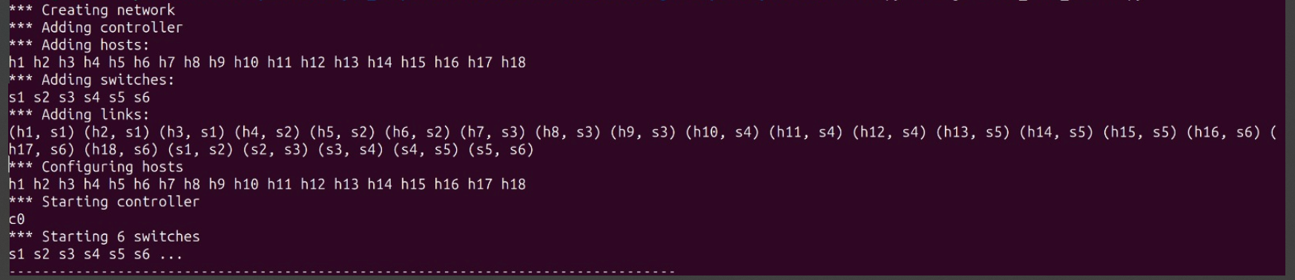
Simulating a network using mininet and RYU controller:

Slide 6
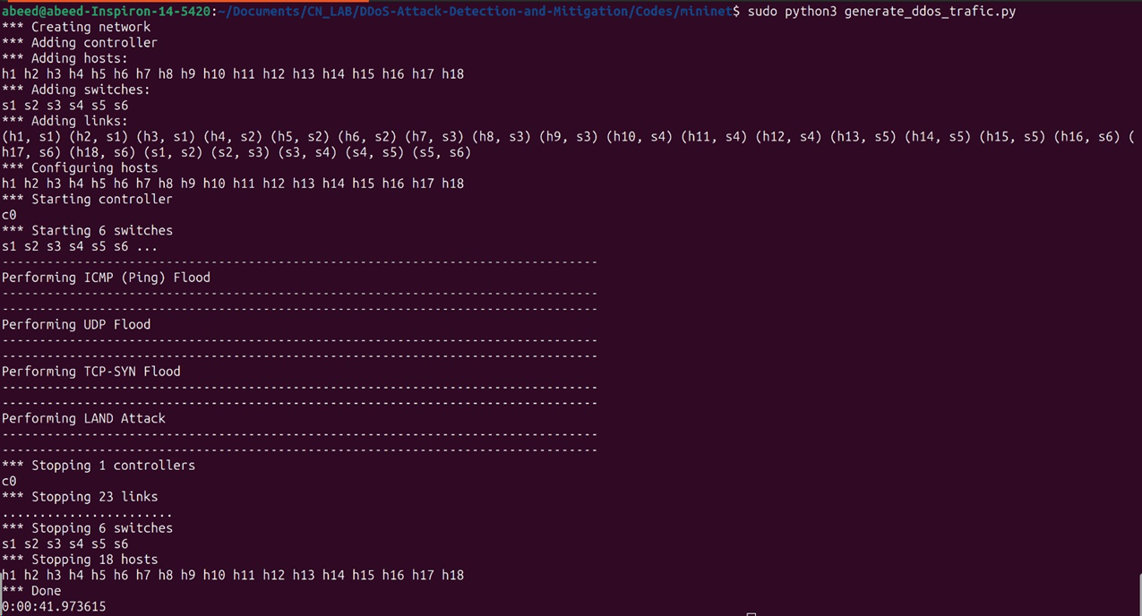
Simulating ddos attack:

Slide 7
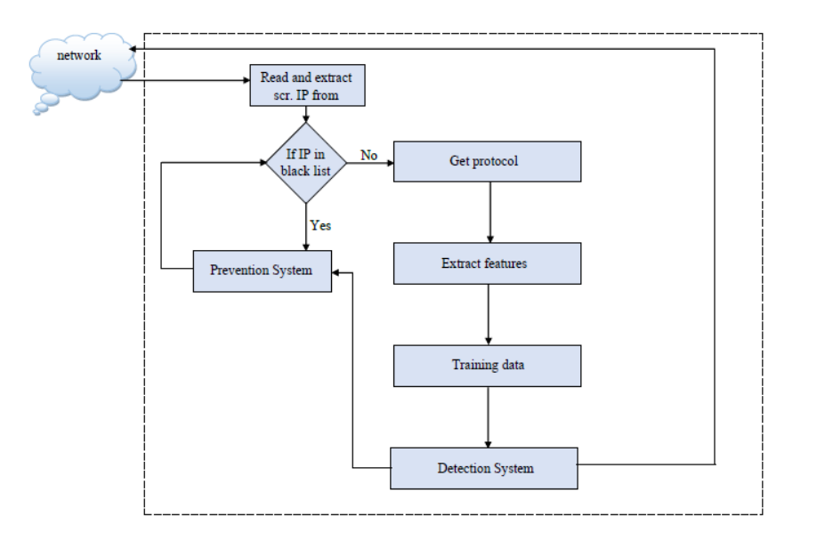
Proposed detection algorithm:
Capture Source IP: Extract the source IP address from network traffic.
Check Blacklist:
If IP not in blacklist, proceed to identify the communication protocol.
If IP is blacklisted, take preventive actions (e.g., block it).
Feature Extraction: Extract relevant features (e.g., packet size, ports) from network data.

Slide 8
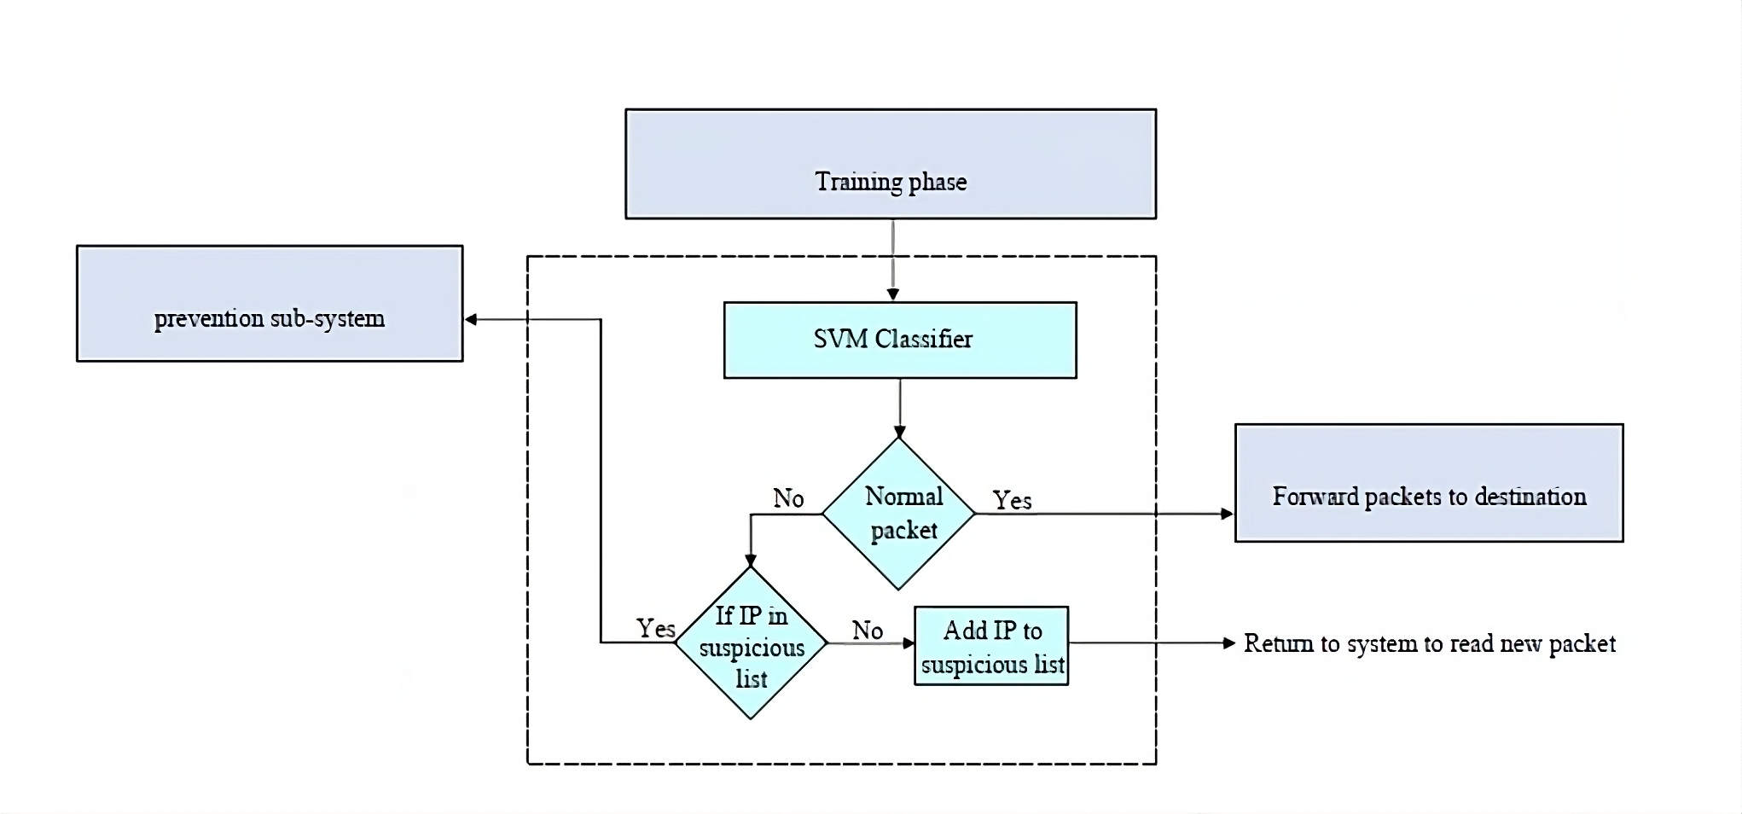
Detection Procedure:
Train ML Model: Use extracted features to train a machine learning model.
2.Detection System: Analyze incoming traffic using the trained model.
3.Classification: Classify traffic as normal or malicious.

Slide 9
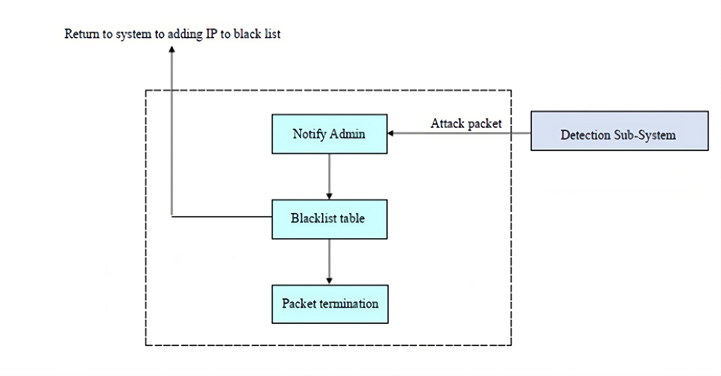
Mitigation algorithm:

Slide 10
Dataset features:
Feature | Description
dt | Timestamp of the event
switch | Switch ID
src | Source IP address
dst | Destination IP address
pktcount | Count of packets in the flow
bytecount | Count of bytes in the flow
dur | Duration of the flow in seconds
dur_nsec | Duration of the flow in nanoseconds
tot_dur | Total duration of the flow
flows | Number of flows
packetins | Count of packet insertions
pktperflow | Packets per flow
byteperflow | Bytes per flow
Feature | Description
pktrate | Packet rate per second
Pairflow | Pair flow
Protocol | Protocol used in the flow (e.g., TCP, UDP)
port_no | Port number
tx_bytes | Transmitted bytes
rx_bytes | Received bytes
tx_kbps | Transmitted kilobits per second
rx_kbps | Received kilobits per second
tot_kbps | Total kilobits per second
label | Label indicating the classification or outcome of the flow

Slide 11
RESULTS:
Using All Features
Algorithm | Accuracy | Precision | Recall | F1-Score
Logistic Regression | 76.4% | 0.73 | 0.80 | 0.78
Support Vector Machines (SVM) | 97.0% | 0.97 | 0.98 | 0.96
Random Forest | 99.99% | 1.00 | 1.00 | 1.00
K-Nearest Neighbors | 98% | 0.99 | 0.99 | 0.99

Slide 12
RESULTS:
Using Feature Selection:
Feature | Weight
src | 17.87
pktcount | 15.16
dst | 13.64
byteperflow | 12.97
pktperflow | 11.35
pktrate | 11.35
tot_kbps | 9.68
rx_kbps | 9.66
flows | 8.95
bytecount | 4.92
dt | 2.33
Protocol | 1.31
dur | 1.11
tot_dur | 1.11

Slide 13
RESULTS:
Performance with Selected Features:
Algorithm | Accuracy | Precision | Recall | F1-Score
Logistic Regression | 75.21% | 0.85 | 0.77 | 0.81
Support Vector Machine (SVM) | 91.77% | 0.90 | 0.93 | 0.94
Random Forest | 99.42% | 0.99 | 1.00 | 1.00
Decision Tree | 94.19% | 0.91 | 1.00 | 0.95

Slide 14
REferences:

Slide 15

THANK YOU
GROUP 18:
Arihant (21CS01033) Abeed (21CS01072) Priyam (21CS01076)

